Slide 1
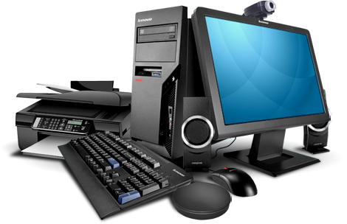


Computer
Hardware
Class V
lab 3

Slide 2

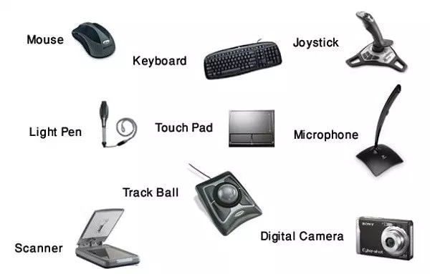
Input Devices
An input device is used to bring data into the system

Slide 3
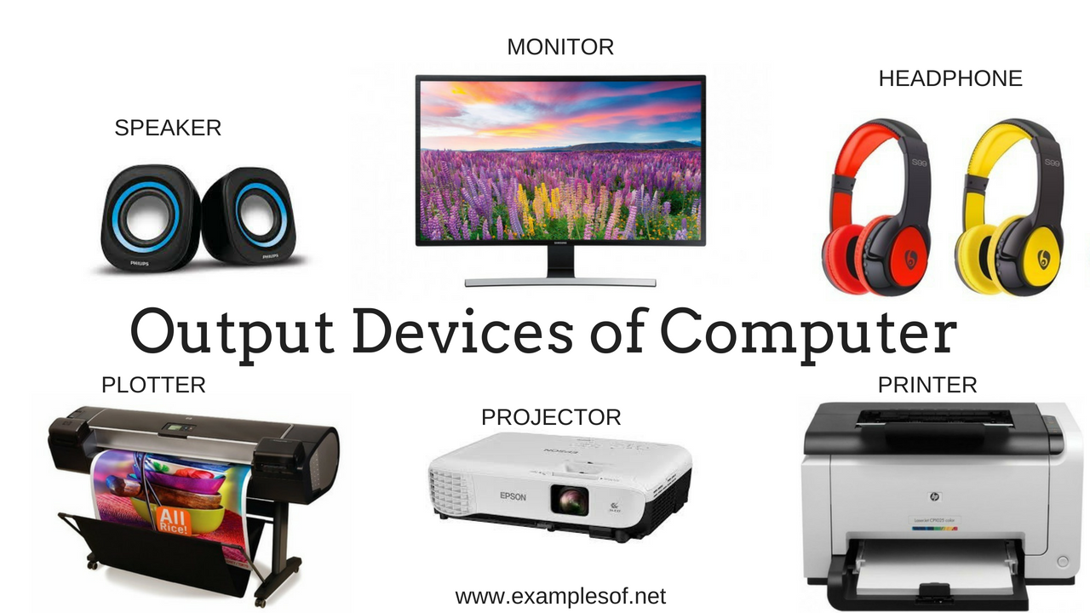
An output device is used to send data out of the system

Slide 4
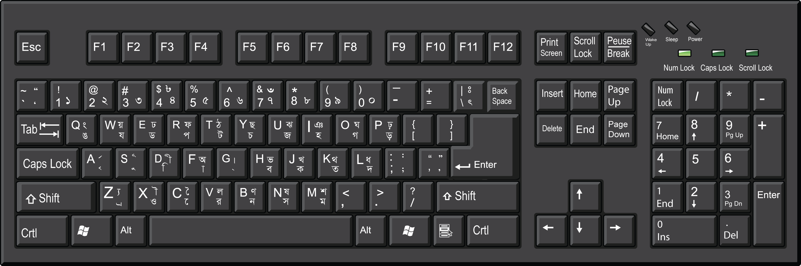
Some Input Devices
Keyboard: a panel of keys that operate a computer

Slide 5
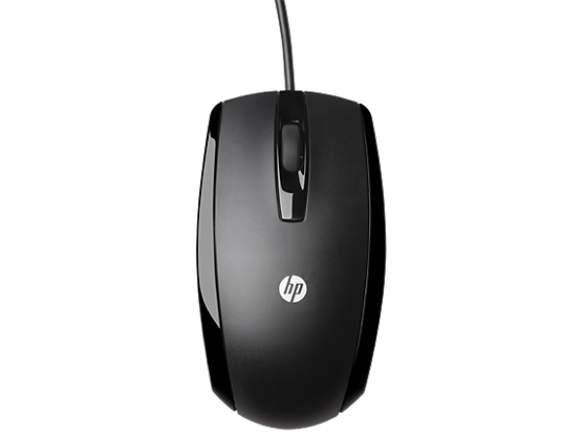
Some Input Devices
Mouse: a pointing device

Slide 6

Some Input Devices
Microphone:captures audio by converting sound waves into an electrical signal

Slide 7
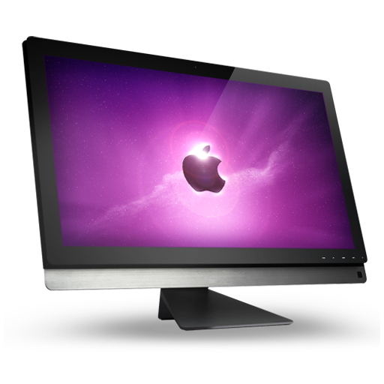
Some Output Devices
Monitor:an output device that displays information in pictorial form

Slide 8
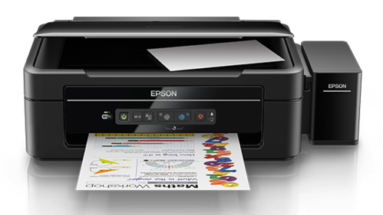
Some Output Devices
Monitor:an output device that displays information in pictorial form

Slide 9


